Slide 1
Selected Topics for IT Security Adversarial Learning: AI as a New Security Target
Lecturer
Huang Xiao
xiaohu (at) in (dot) tum (dot) de
Chair for IT Security (I20), Prof. Dr. Claudia Eckert
Technische Universität München

Slide 2
Outline
Introduction & Motivation
Insight into Learning Models
Adversarial Learning Theory
Adversarial Attacks
Towards Secure Learning
Conclusions
References

Slide 3
Introduction
Machine Learning is not a panacea
Data stationary assumption is usually too strict
Learning-as-a-Service is a trend
Cyber Security is using learning-based solutions
AI system itself can be a threat (intrinsic algorithmic deficiency)
Endless war between adversaries and defenders
Therefore: adversarial and secure machine learning

Slide 4
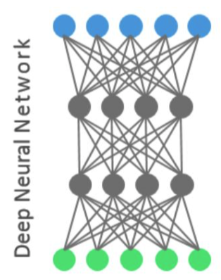
Motivation
To mislead the DNN to give wrong decisions
“It turns out some DNNs only focus on discriminative features in images.”
Nguyen A, Yosinski J, Clune J. Deep Neural Networks are Easily Fooled: High Confidence Predictions for Unrecognizable Images. In Computer Vision and Pattern Recognition (CVPR '15), IEEE, 2015.

Slide 5
Motivation
To bypass the spam-filter by good words attack.
Learning to violate security goals, e.g.,
Integrity is violated, since a positive sample evades being detected.

Slide 6


Motivation
Can you afford technology like Deep learning?
Demanding computational resources
Huge amount of training data
Data scientists are wanted
Learning-as-a-service, e.g., Google predictive API, MS Azure, IBM Watson, AWS ML. etc…
Adversaries know the whom to attack now..
Google Brain
~16,000 computers + 10 Mio images
to learn a cat

Slide 7

Definition
Adversarial Learning is the reverse engineering of machine learning.
It aims to design robust and secure learning algorithms.
Related areas:
Learning theory Game theory IT security Robust statistics Differential privacy
Know your enemies and yourself,
you will not be imperiled in a hundred
battles.
–Sun Tzu, The Art of War, 544 BC

Slide 8
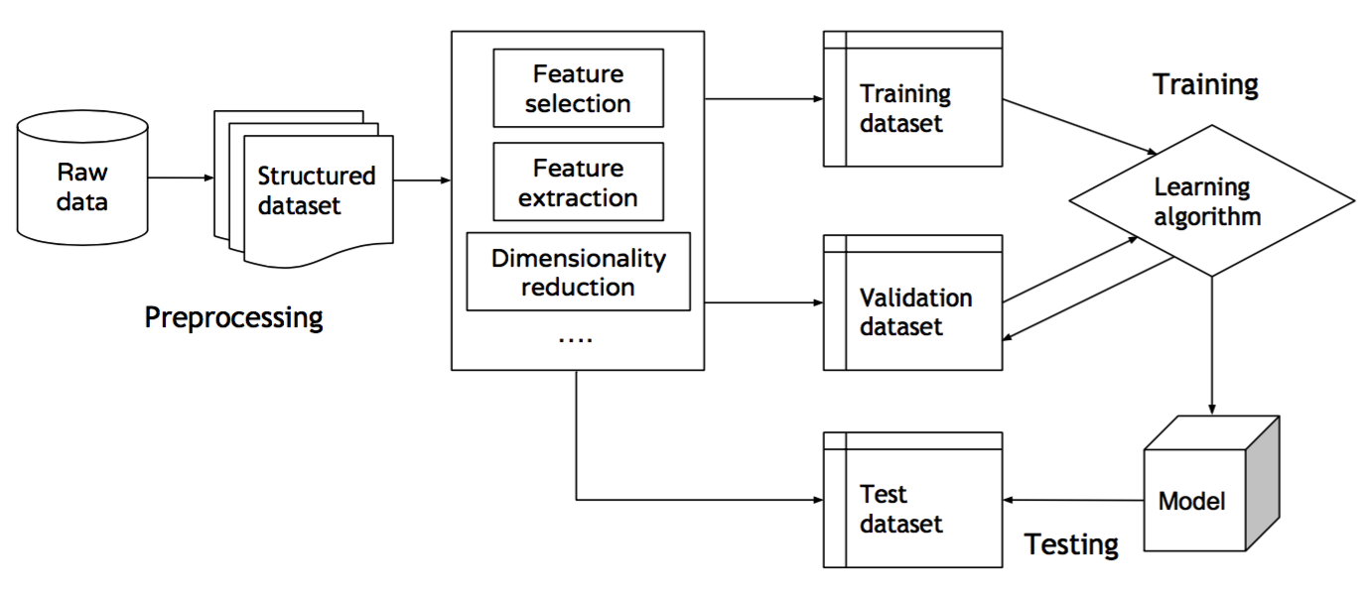

Learning under Adversarial Impact
Data stationary assumption might be wrong

Slide 9
Learning under Adversarial Impact
False features
Poison learning
Data stationary assumption might be wrong
Evade testing

Slide 10
Outline
Introduction & Motivation
Insight into Learning Models
Adversarial Learning Theory
Adversarial Attacks
Towards Secure Learning
Conclusions
References

Slide 11
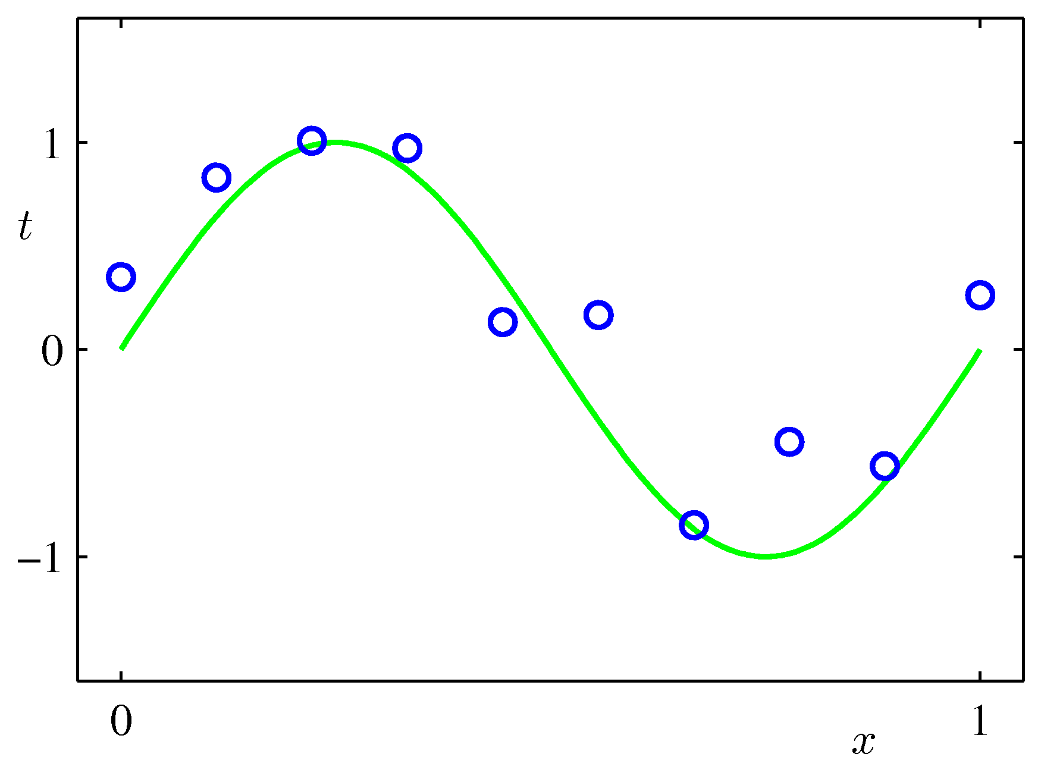

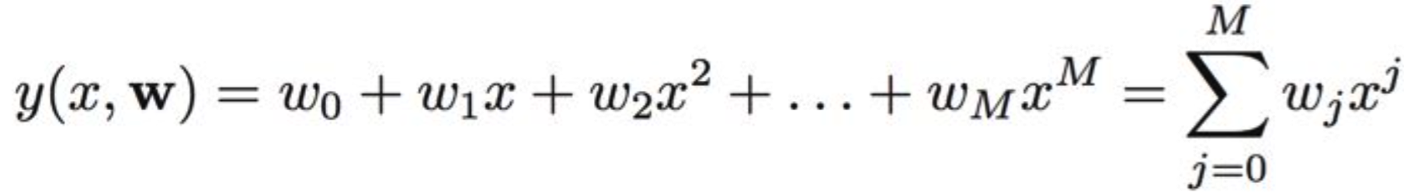
Inside the learning
A polynomial fitting example, use a M-polynomial to fit the training data..
True signal
Linear parameters we want to learn
Observations
=
+
Noise
Q: how to choose M?
Q

Slide 12
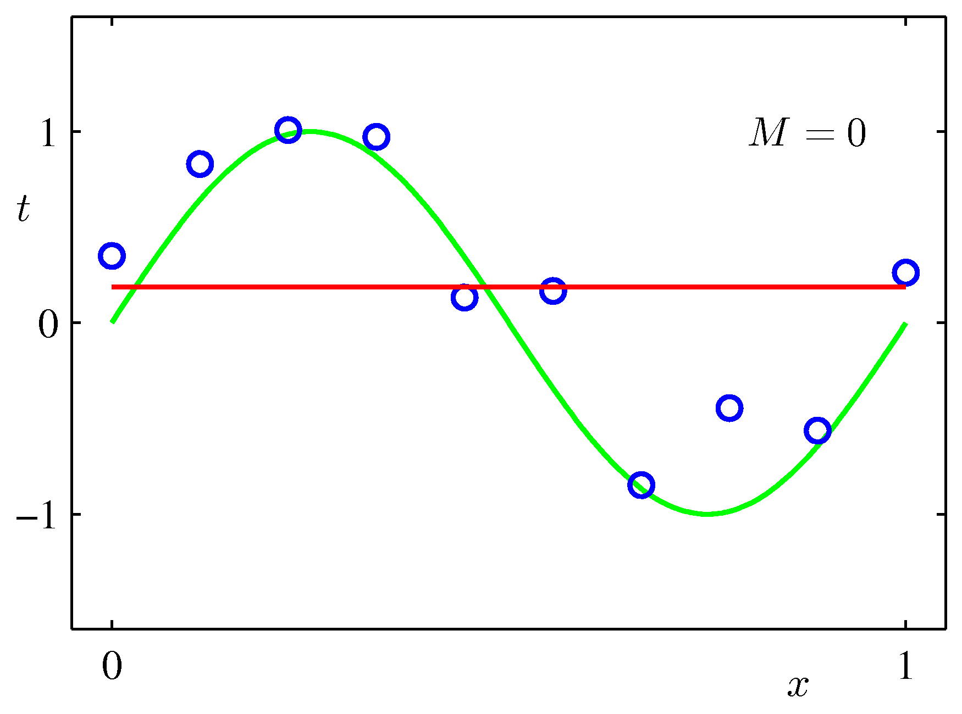
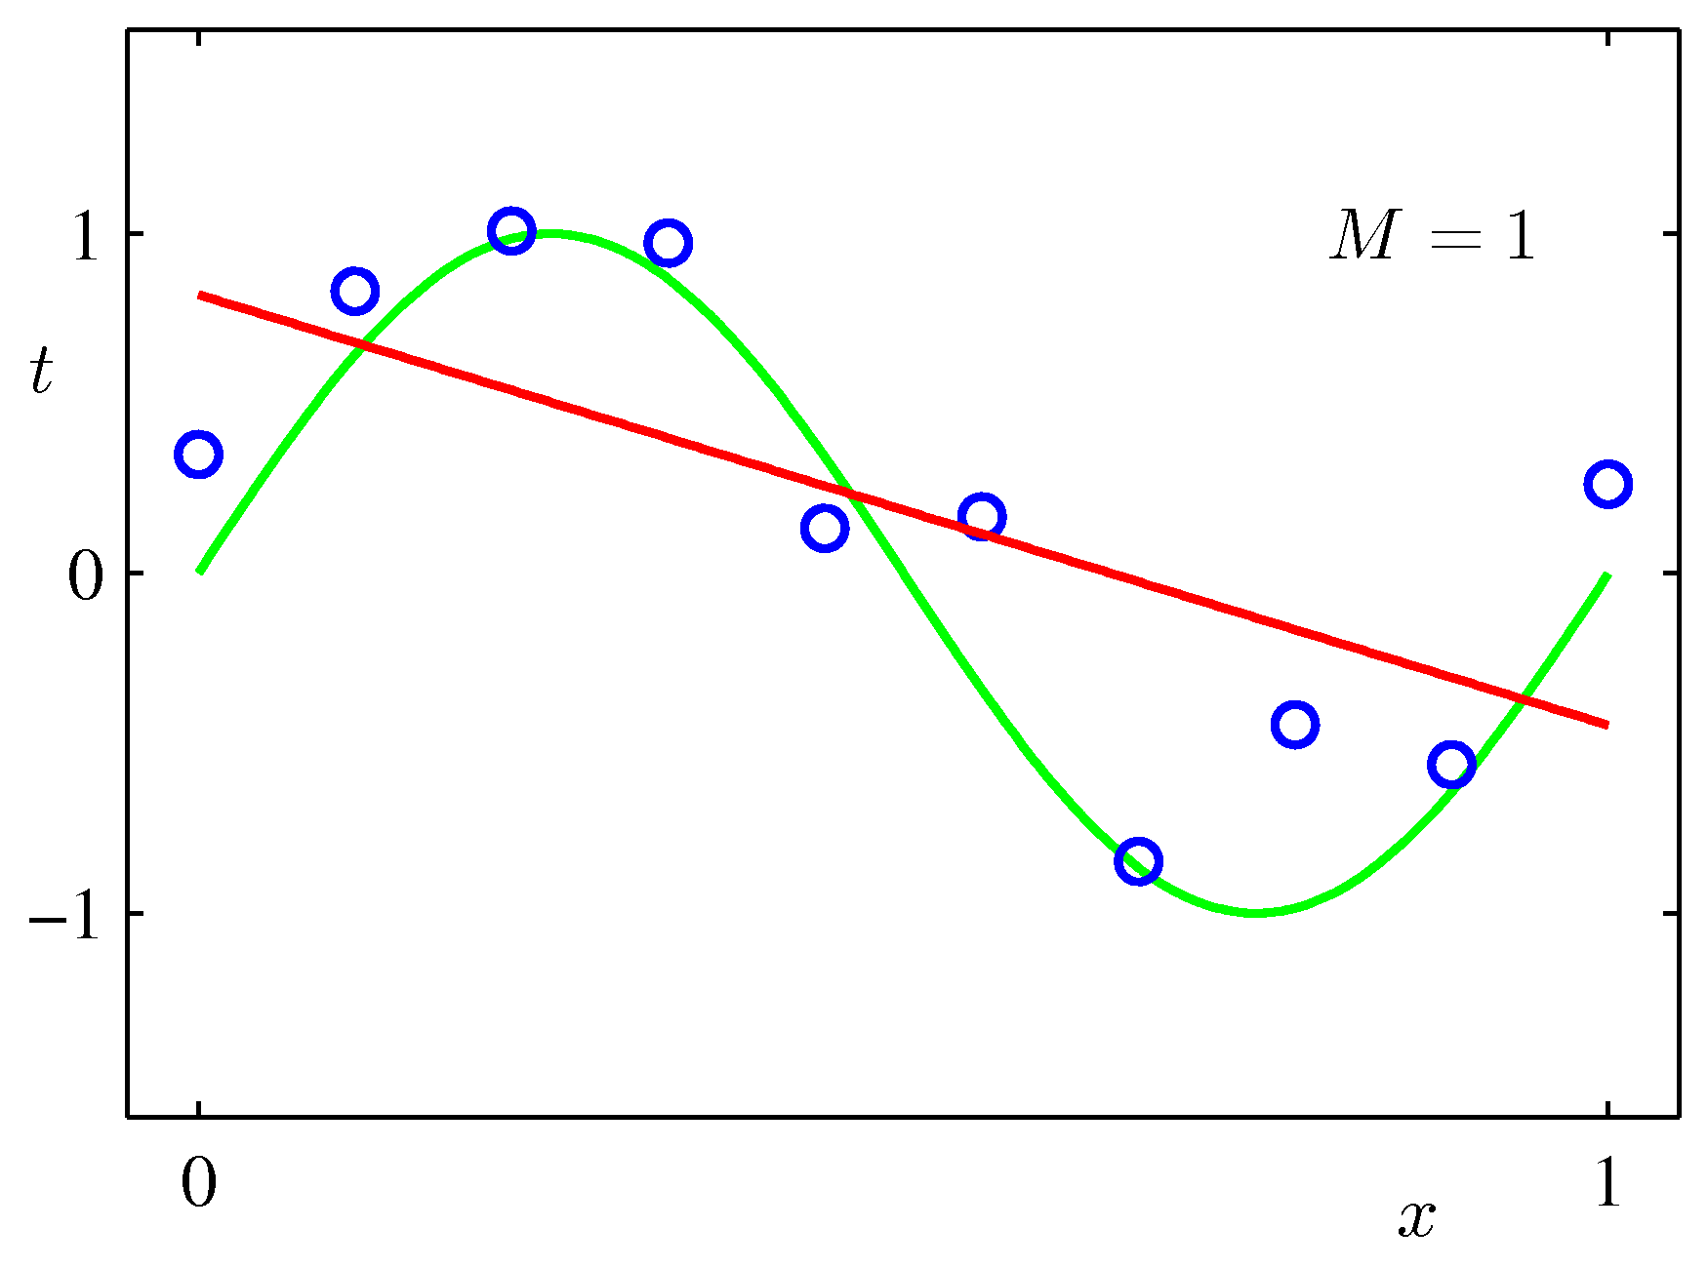
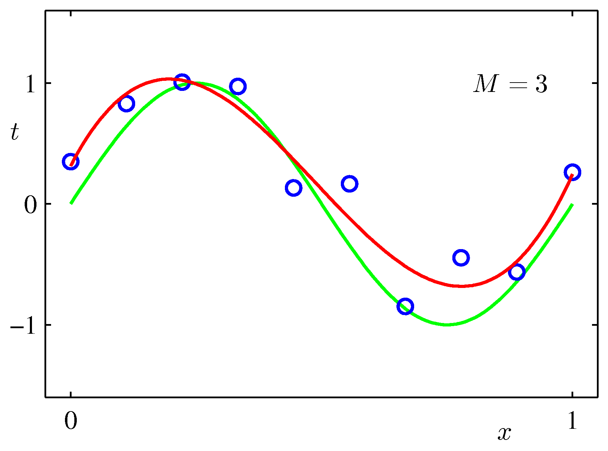
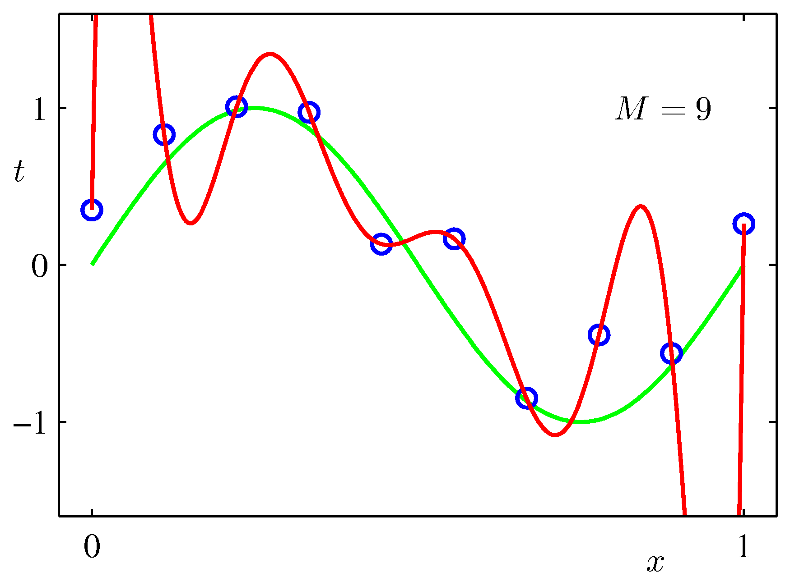
Inside the learning (cont.)
Training this linear model: e.g., minimize least square
Estimated output
True target
Function complexity

Slide 13
Model Selection
Training this linear model: e.g., minimize least square
Estimated output
True target
Function complexity
Underfitting
Underfitting
Good
Overfitting

Slide 14
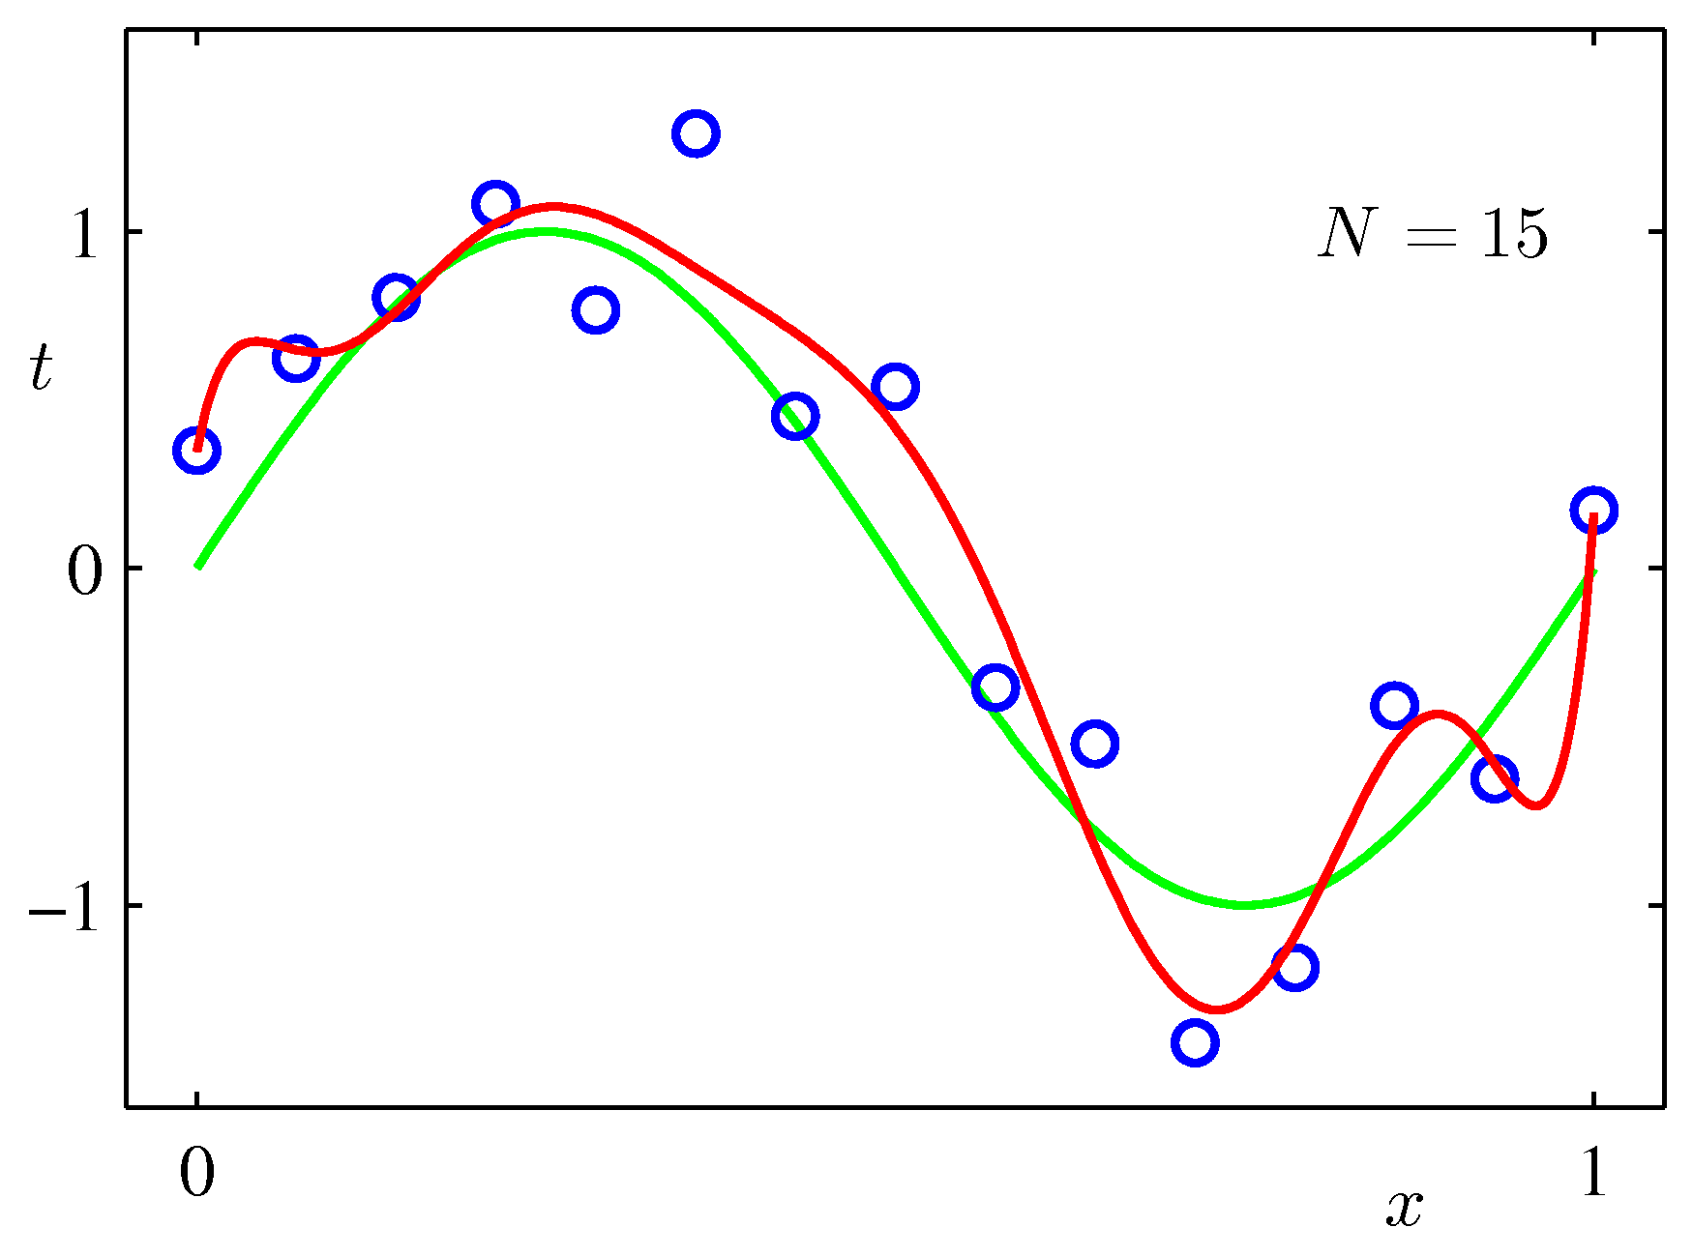
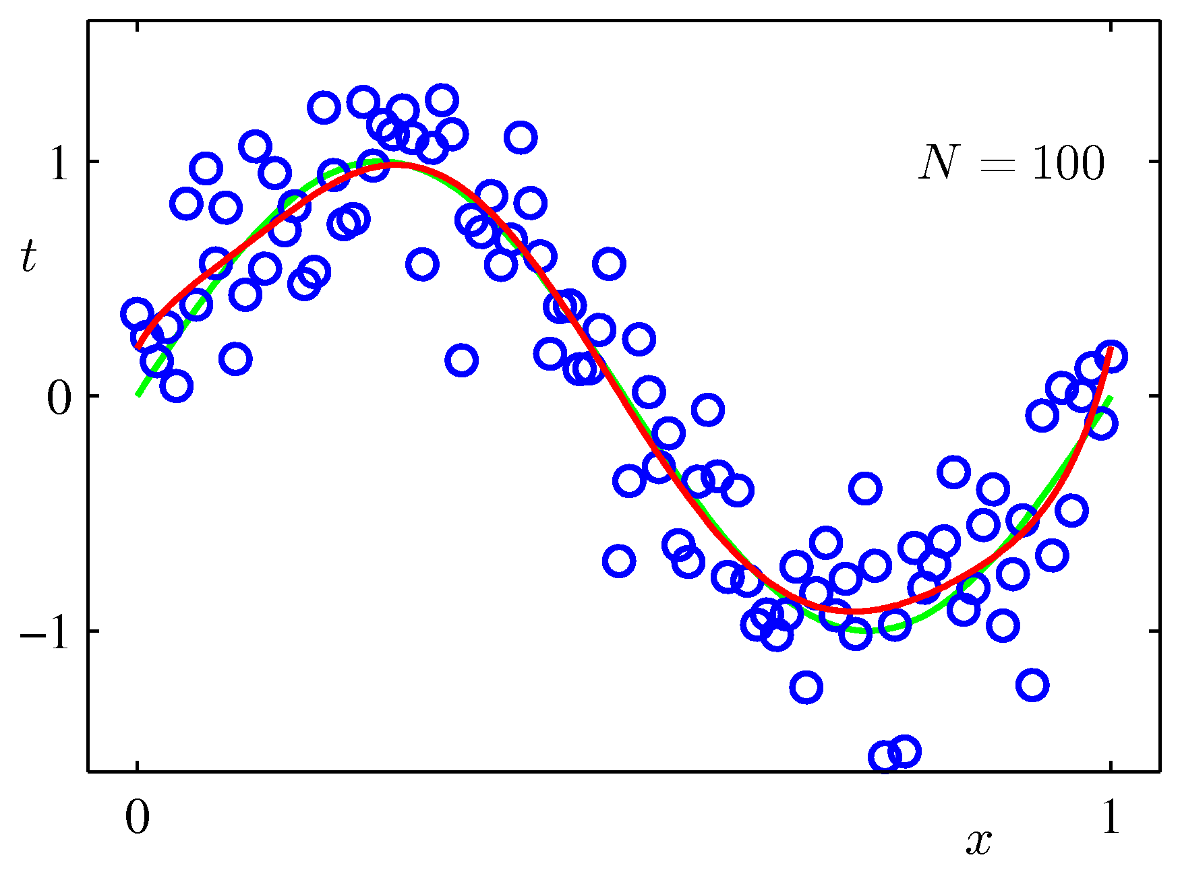
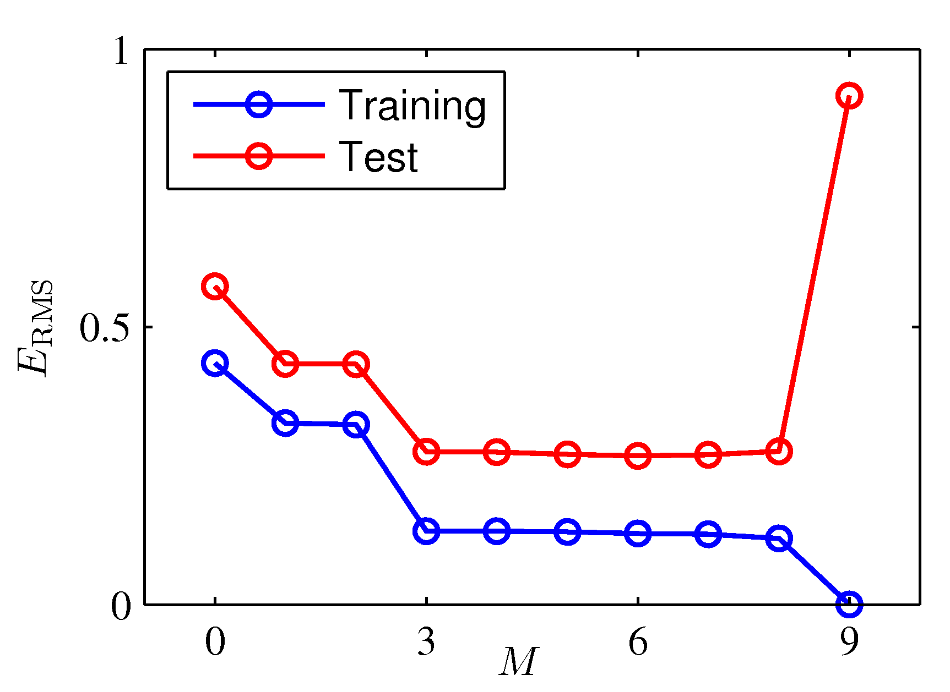
Overfitting
Overfitting means noise is dominating your model!
Overfitting is the central problem of ML.
Generalization of model
Bad on unseen test set
Avoid overfitting:
E.g., regularization term, prior, more data, model selection

Slide 15
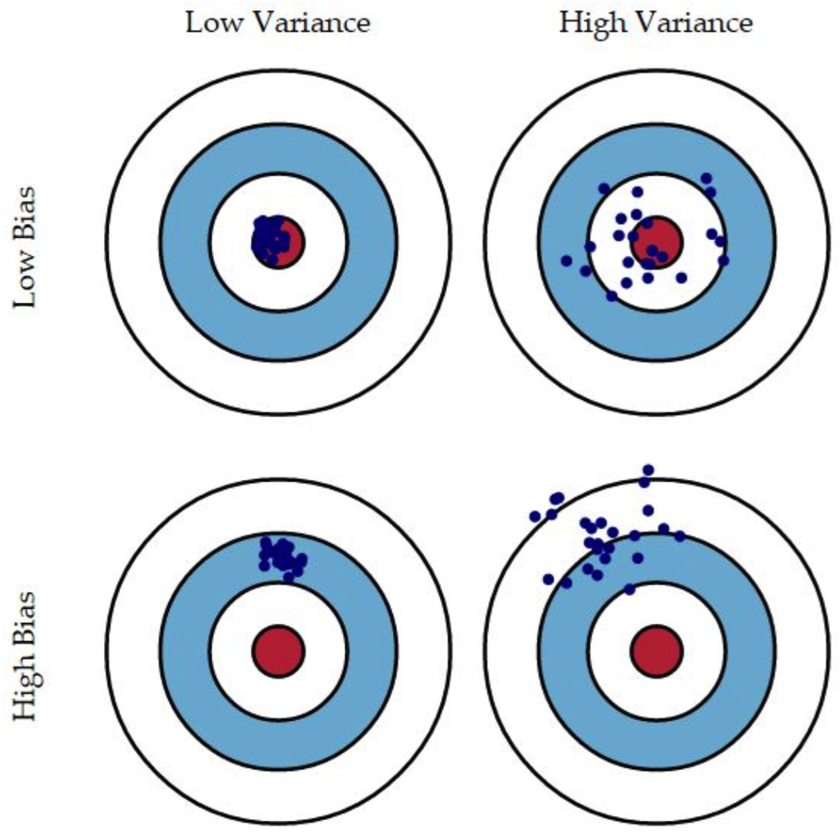
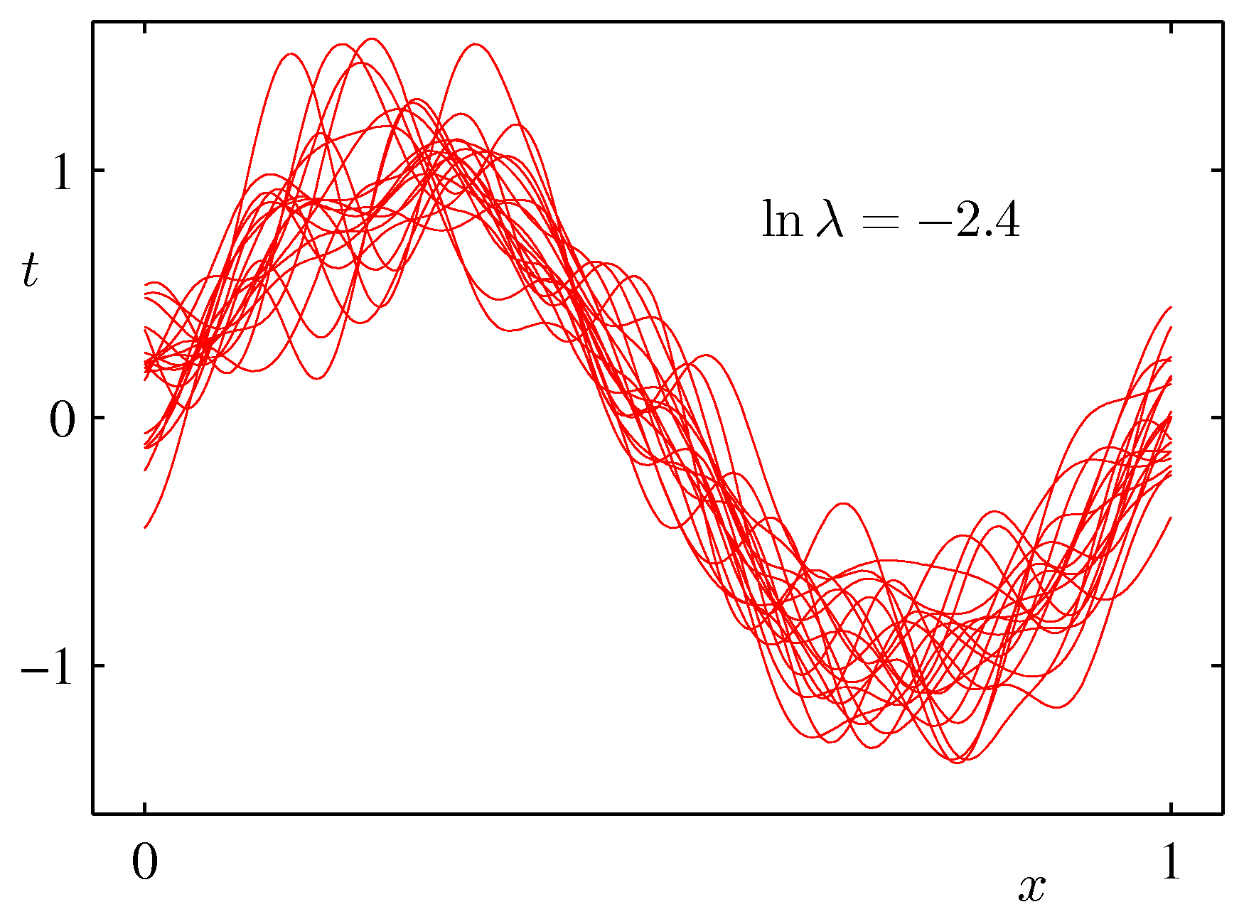
Bias vs. Variance
Q: for adversaries, they want to increase bias or variance?
Functions are trained on 100 bootstaps
Overfitting: low bias, high variance
Underfitting: high bias, low variance

Slide 16
Outline
Introduction & Motivation
Insight into Learning Models
Adversarial Learning Theory
Adversarial Attacks
Towards Secure Learning
Conclusions
References

Slide 17
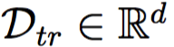
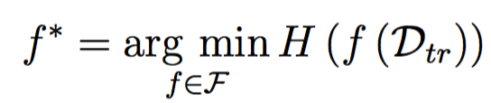
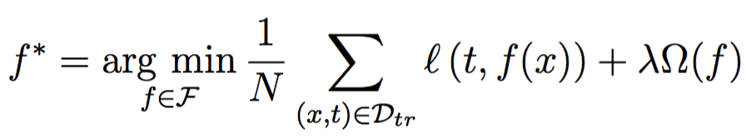
Learning formulation
To learn a model from training dataset
Namely selecting an optimal function from a function space F, where the evaluation function H is minimized.
Empirical Risk Minimization
Loss function evaluating empirical risk
Regularization term controlling the function complexity

Slide 18
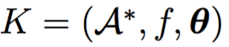
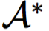
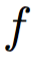
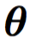
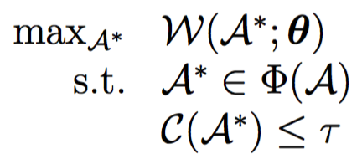
Adversarial Modeling
An adversary is defined as a vector encoded in a 3-tuple
Optimal subset of adversarial samples
The targeting learning model
Attacker’s knowledge
An attack strategy can be defined as
e.g., classification error
is maximised
Choose adversarial samples
Cost function of introducing adversarial noise

Slide 19
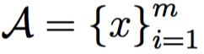
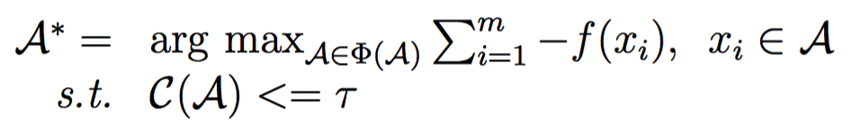
An example
A spam-filter is a binary classifier discriminating an emails as either spam ( ) or legitimate ( ) . Now suppose an adversary can compose a set of spams and send to ,,
Now the adversary can choose the adversarial samples by
It equals classifying most of the emails as legitimate. Note that Attacker’s knowledge of the spam filter can be acquired by query-response interface provided by client.

Slide 20
Adversarial Capability
 | Access to data | Knowledge about features | Knowledge about classifier
Poor Knowledge | From same distributional or not at all | No | No
Limited Knowledge | Partially or from same distributional | Maybe or inferred | Yes
Perfect Knowledge | Yes | Yes | Yes

Slide 21
Taxonomy of Adversarial Attacks
Attacker’s goal
E.g., maximize a classification error, compromise feature selection, etc..
Attacker’s knowledge
Knowledge about the training data
Knowledge about the learning function
Knowledge about the features
Security violation
Integrity
Availability
Adversarial Influence: Causative vs. Evasive
Specificity: targeted vs. indiscriminative

Slide 22
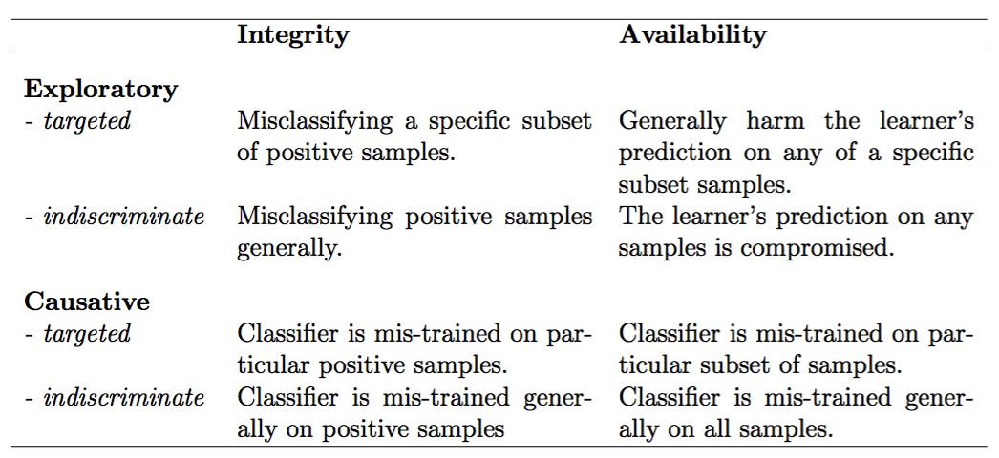
Taxonomy of Adversarial Attacks
E.g., Indiscriminate Causative Availability Attack aims to cause the classifier to misclassify samples indiscriminatively.

Slide 23
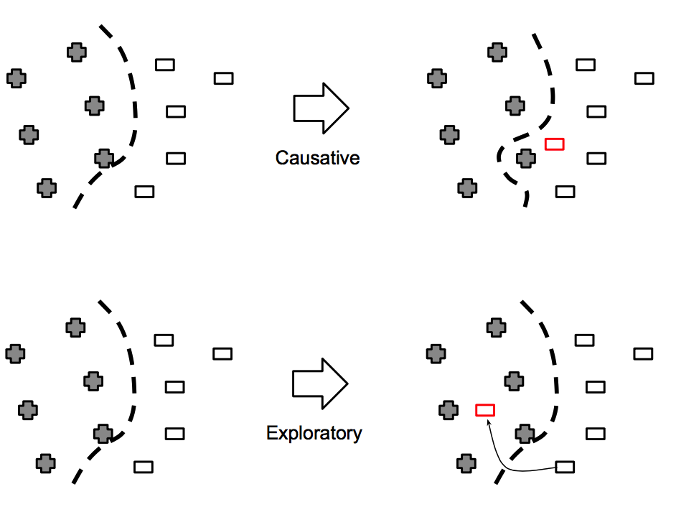
Typical Attack Types
Causative (Poisoning) vs. Exploratory (Evasion)
Change the classifier
Evade the classifier

Slide 24
Outline
Introduction & Motivation
Insight into Learning Models
Adversarial Learning Theory
Adversarial Attacks
Towards Secure Learning
Conclusions
References

Slide 25
Types of Adversaries
Causative (poisoning attack)
Cracking how the learning algorithm works
Engineering on features or labels of training set
Change the discriminant function eternally
Evasive (exploratory attack)
Engineering features of an evading point (test phase)
Circumvent the legitimate function
Change the discriminant result, not the function

Slide 26
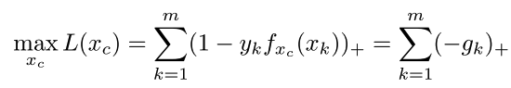
Poisoning attack on SVMs
Inject adversarial noises on features
Data stationary assumption is broken
Adversarial objective: maximizing the error
E.g., test error, hinge loss, generalization error
Using gradient ascend w.r.t the attack points
Adversarial sample
we want to find out
The classifier is retrained on
compromised dataset

Slide 27
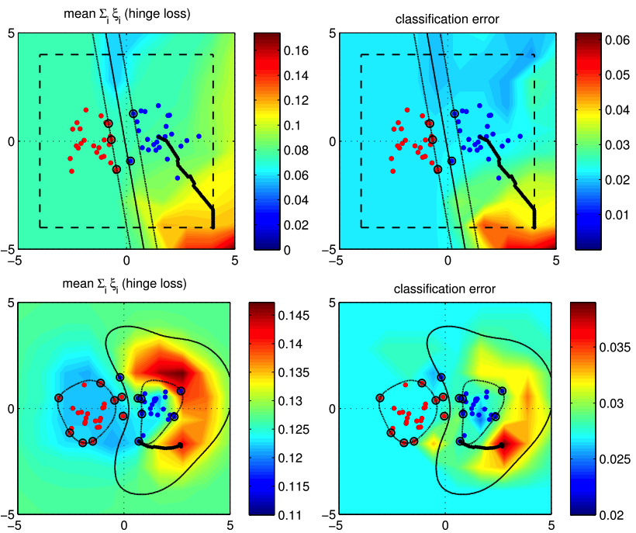
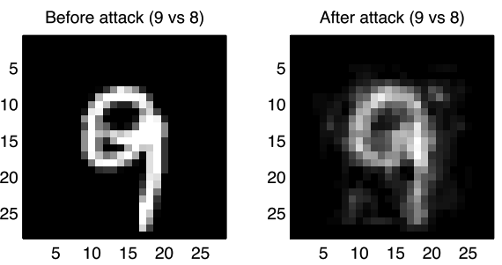
Poisoning attack on SVMs
On MNIST digits dataset, a ‘9’ image is blurred as being a ‘8’ after attack
How adversarial samples are computed on both linear and RBF kernels (see bold gradient path)

Slide 28
Evasion Attacks
Properties
Directedness
Directed: approximate a point towards a certain one
Undirected: probing the model boundary
Closeness
Measure how closely an adversarial sample approaches its expected area
Adversarial cost
How much effort must be put to achieve its effect

Slide 29
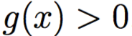
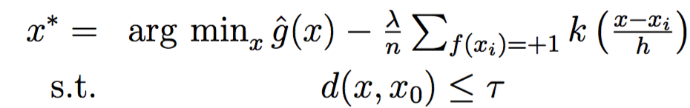
Mimicry Attack on SVMs
Again, we consider binary SVMs. A reckless attacker wants to manipulate a positive sample with decision function , to evade being detected as positive. The evasion is defined as,
Proxy classifier approximating target in case we don’t know the true classifier
Meanwhile we don’t want the point go to the dense area of targeting class.

Slide 30
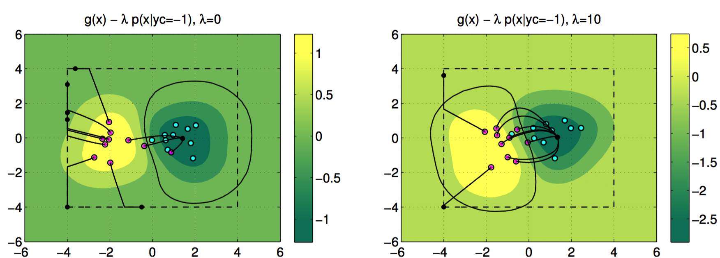
Mimicry Attack on SVMs
Points are evading the class boundary towards dense area of opposite class.

Slide 31
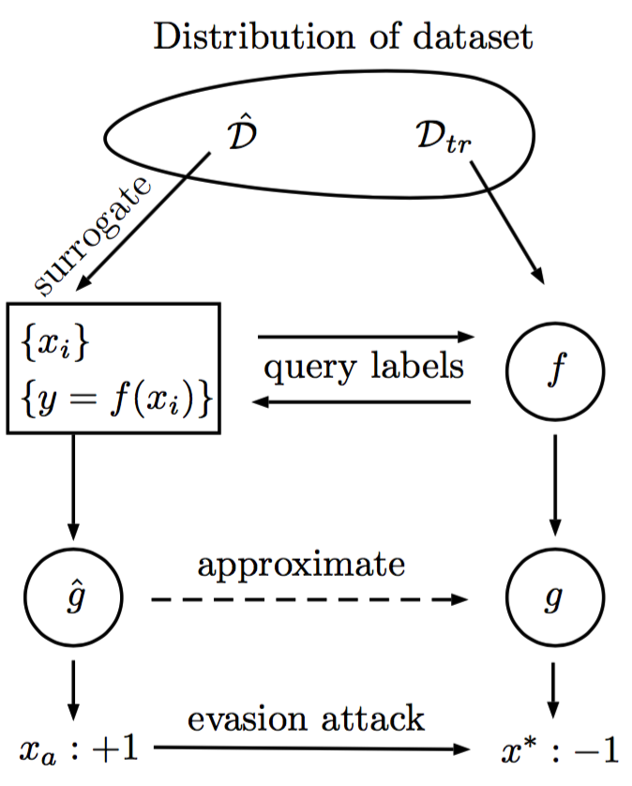
Evasion Attack Simulation
1. Collecting data from the same distribution, e.g., images of elephants by Google
2. Query labels by public interface
3. Simulating a proxy classifier
4. Compute evading samples on proxy classifier

Slide 32
Outline
Introduction & Motivation
Insight into Learning Models
Adversarial Learning Theory
Adversarial Attacks
Towards Secure Learning
Conclusions
References

Slide 33
Towards Secure Learning
Attack is not our goal, but the only way to security
Designing robust and secure learning algorithms
Possible methods, e.g.,:
Adaptive regularization
Multiple Classifier Systems (or ensemble)
Learning with adversarial samples
Robust statistics

Slide 34
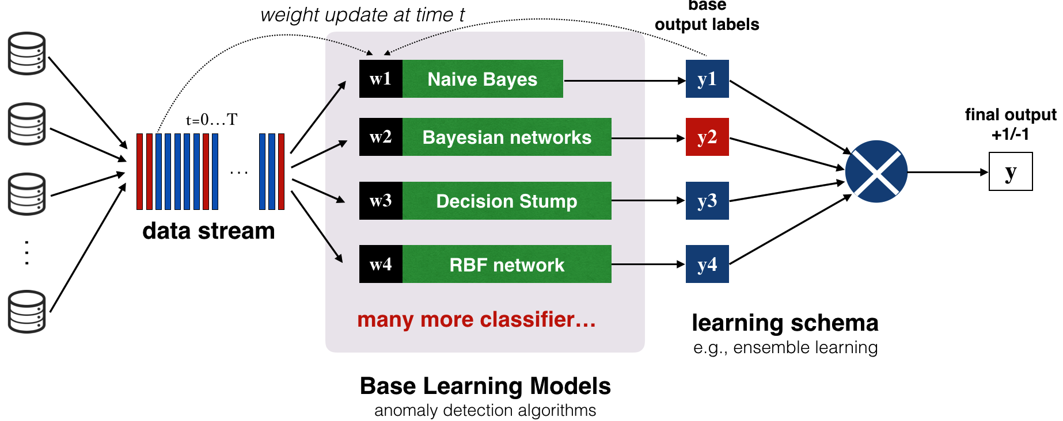
Multiple Classifier Systems
Main idea is to adapt classifier to external changes

Slide 35
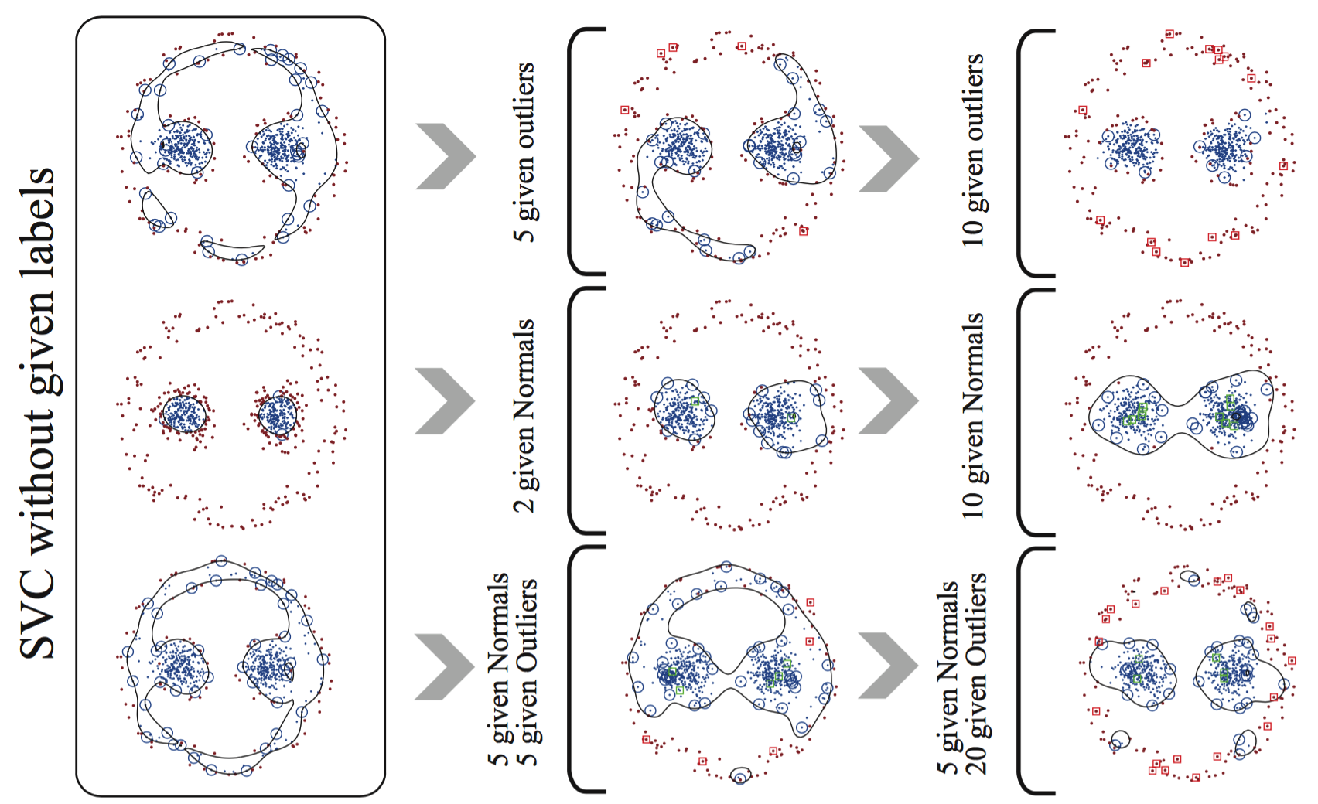
Adaptive Regularization
Penalty on various points is defined as different.

Slide 36
Outline
Introduction & Motivation
Insight into Learning Models
Adversarial Learning Theory
Adversarial Attacks
Towards Secure Learning
Conclusions
References

Slide 37
Conclusions
Machine learning is powerful but not always reliable
Integrity and availability of big data systems can be compromised
Adversarial learning is a rising research area
Traditional IT security must be patched with securing learning based systems
Causative and evasive attacks are real and potentially dangerous
Secure and robust design of learning algorithms are expected
Robustness can be enhanced by model smoothing （MCS） or adaptive regularization, for example.

Slide 38
References
Biggio, B., Nelson, B. and Laskov, P., 2012. Poisoning attacks against support vector machines. In J. Langford & J. Pineau, eds. ICML. Omnipress, pp. 1807–1814.
Biggio, B. et al., 2013. Evasion attacks against machine learning at test time. In H. Blockeel et al., eds. European Conference on Machine Learning and Principles and Practice of Knowledge Discovery in Databases (ECML PKDD), Part III. Lecture Notes in Computer Science. Springer Berlin Heidelberg, pp. 387–402.
Xiao, H. and Eckert, C., 2013. Indicative Support Vector Clustering with its Application on Anomaly Detection. In ICMLA. Miami, Florida, USA.
Barreno, M., Nelson, B., Joseph, A.D. and Tygar, J.D., 2010. The security of machine learning. Machine Learning, 81(2).
Barreno, M. et al., 2006. Can machine learning be secure? In Proceedings of the 2006 Symposium on Information, computer and communications security. ASIACCS ’06. New York, NY, USA: ACM, pp. 16–25.
Ben-hur, A. and Aviv, T., 2000. A Support Vector Method for Clustering. Proc. of the 15th International Conference on Pattern Recognition.
Dalvi, N. et al., 2004. Adversarial classification. In Proceedings of the 2004 ACM SIGKDD international conference on Knowledge discovery and data mining - KDD ’04. Seattle, p. 99.
Lowd, D. and Meek, C., 2005. Adversarial Learning. In A. C. M. Press, ed. Proceedings of the Eleventh ACM SIGKDD International Conference on Knowledge Discovery and Data Mining (KDD). Chicago, IL, USA: ACM Press, pp. 641–647.
Nguyen, A., Yosinski, J. and Clune, J., 2014. Deep Neural Networks are Easily Fooled: High Confidence Predictions for Unrecognizable Images. In Computer Vision and Pattern Recognition 2015. Boston, Massachusetts, US.
Xiao, H. et al., 2015. Is Feature Selection Secure against Training Data Poisoning ? Int’l Conf. on Machine Learning (ICML).
Xiao, H. et al., 2014. Support Vector Machines under Adversarial Label Contamination. Journal of Neurocomputing, Special Issue on Advances in Learning with Label Noise, 160(0)., pp.53–62.

